Slide 1

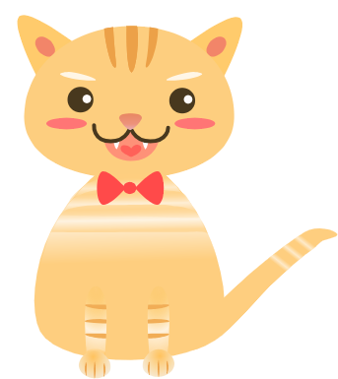
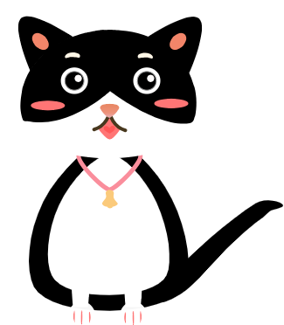
Happy Breeder
Yinjie Gao, Jie Lian, Xinduo Chen, Ruoqing Cheng

Slide 2
Background
Breed Cats!
Notes:
We are planning to build a web-based social simulation game. Users would play the role of breeders.

Slide 3
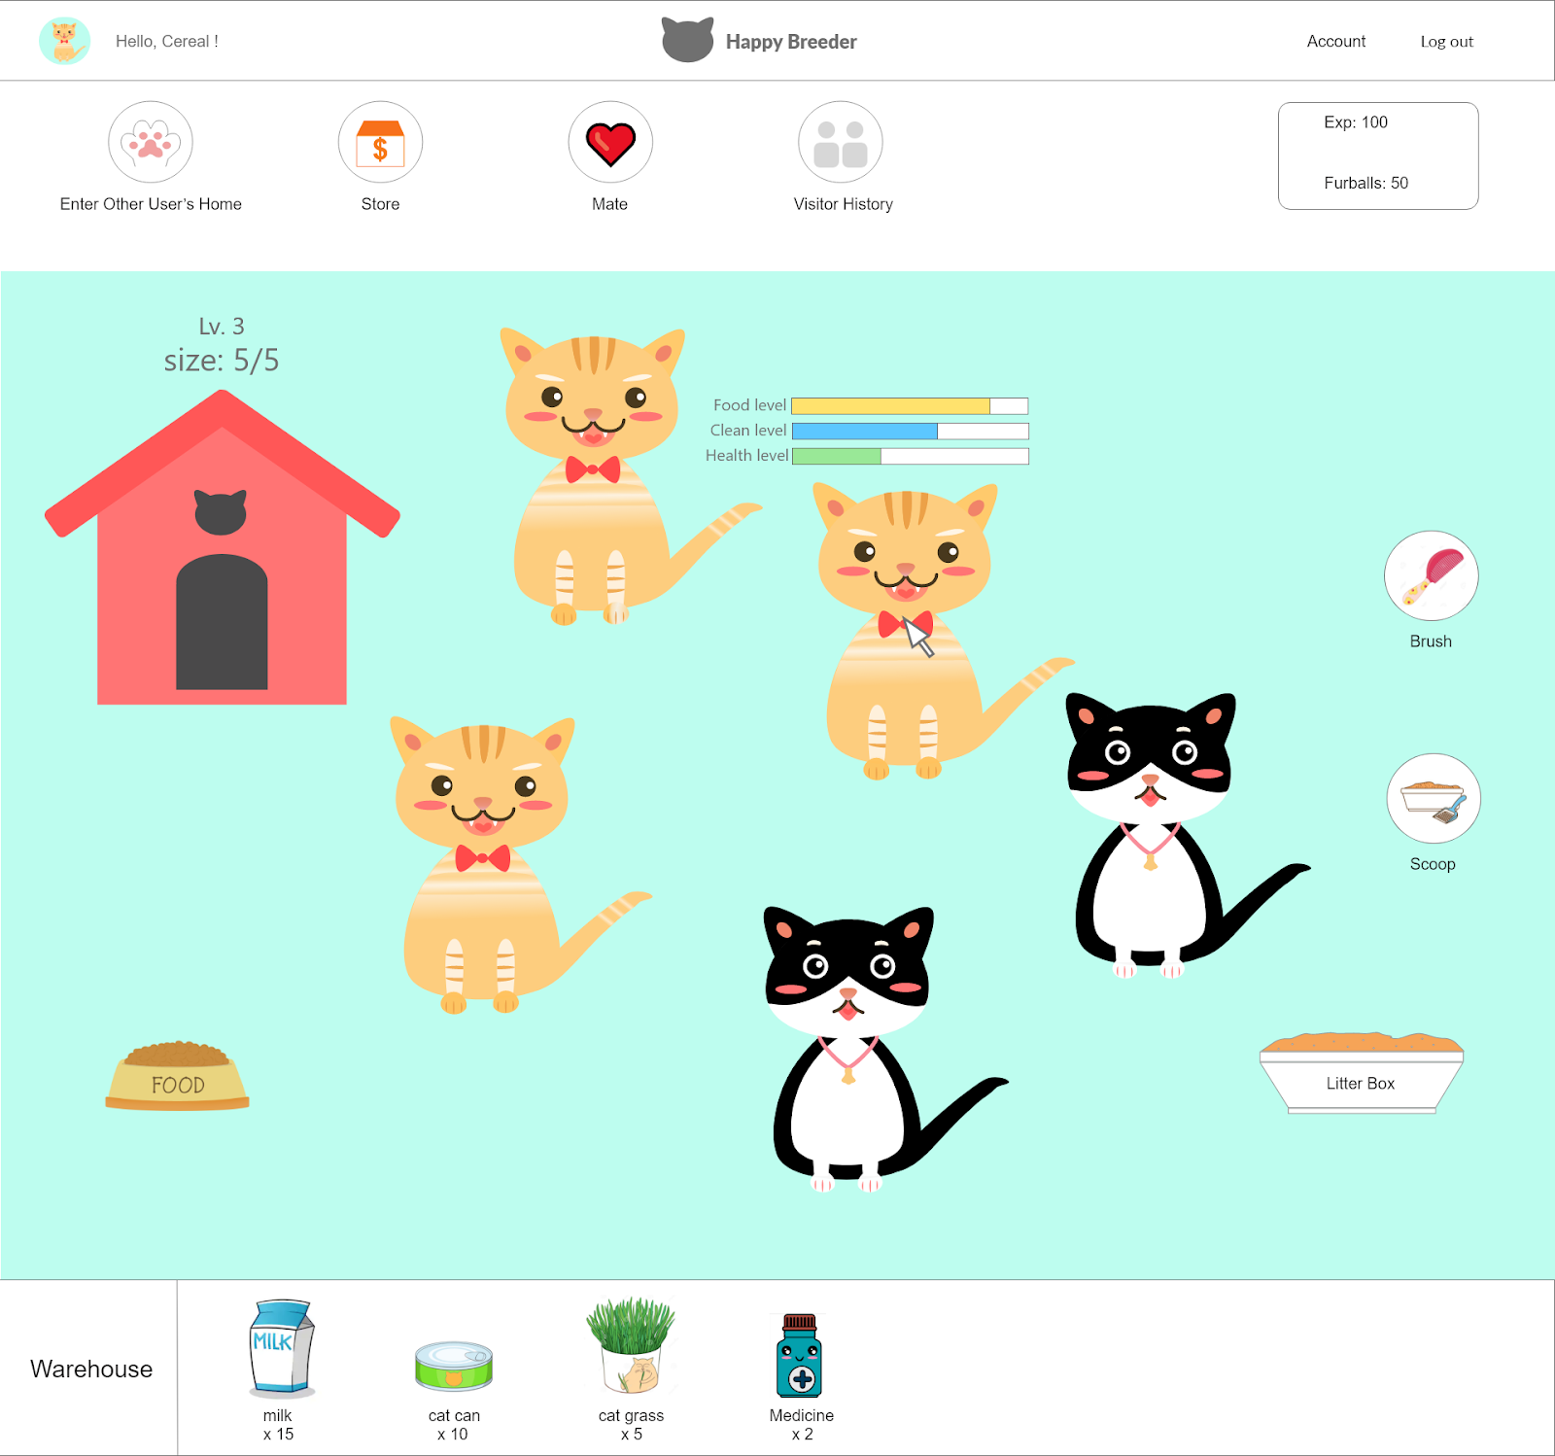
Background
Complete daily task
Day care
Breed kittens
Collect furball
Notes:
They need to complete certain tasks to gain ‘fortune’ and ‘experience’. Their tasks include:
Daycare (feeding, grooming, medical care, etc.) Patting their cats or other breeders’ cats to gain furballs as fortune to buy more items in the store for a better daycare Breed kittens for selling in the store

Slide 4
Background
Complete daily task
Exp
Exp Fortune
Fortune
Notes:
We can get experience and fortune through those daily task.

Slide 5
Background
Exp
Fortune
More capacity for cats
Level up
Notes:
Leveling up cattery to have more capacity of cats(Yay!!!).
Leveling up costs fortune and experience. Purchasing food, and toys also cost fortune.
Breeders can also interact with their friends by visiting each others’ kennels and pat their pets to gain extra fortune(we use furball as currency).
Notice: Cats have “patting” limits. Breeders can only pat a cat to certain times a day.

Slide 6
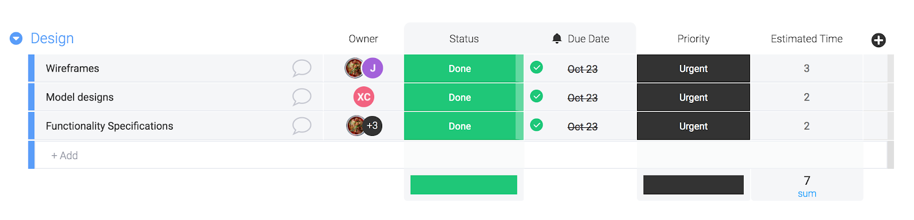
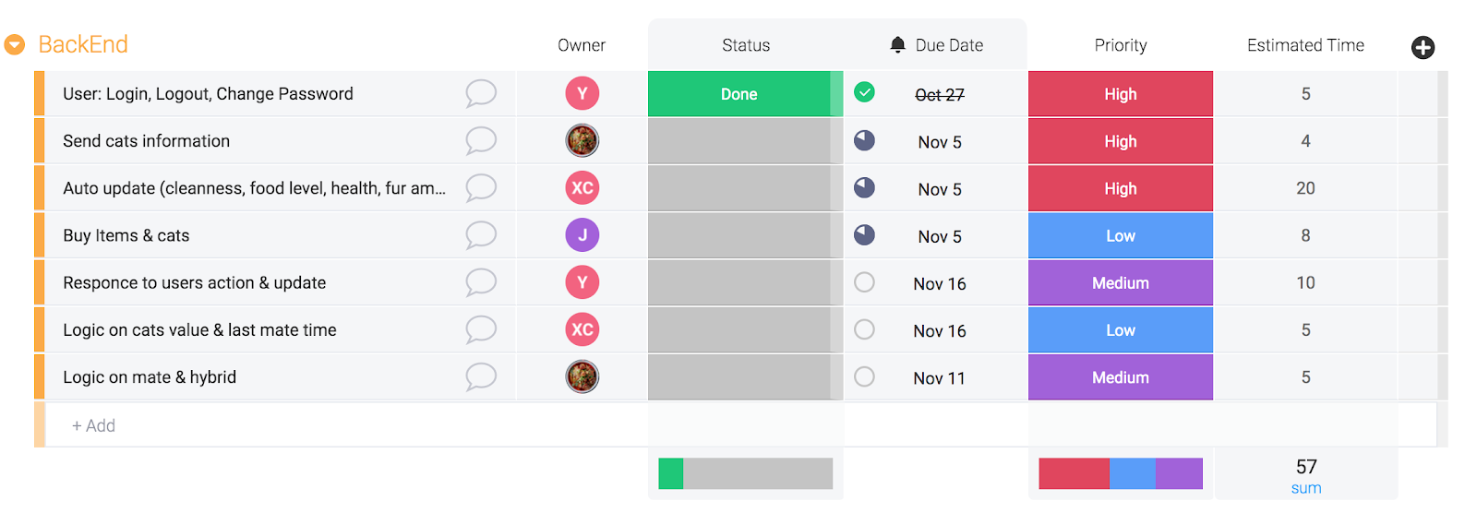
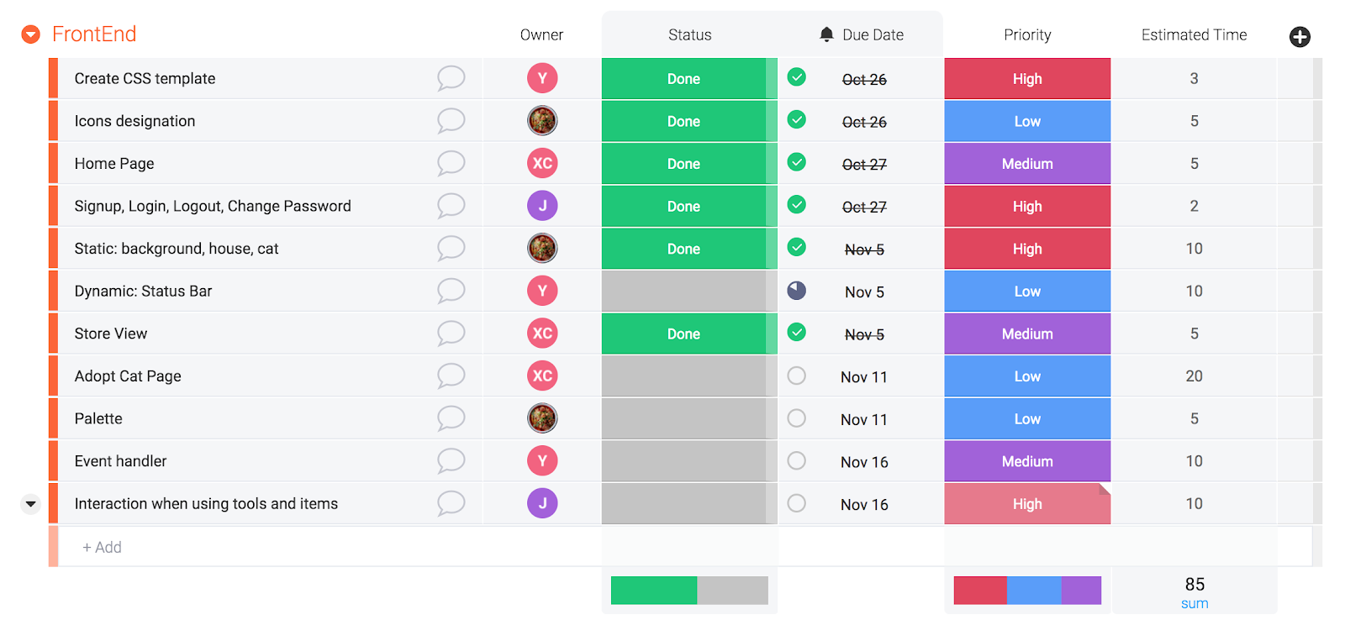
Plan and Progress
Notes:
So far, we finishes the static layout for our front end, including the main page for breeding cats and store page to purchase food and medicines. Also, we finished registration part.

Slide 7
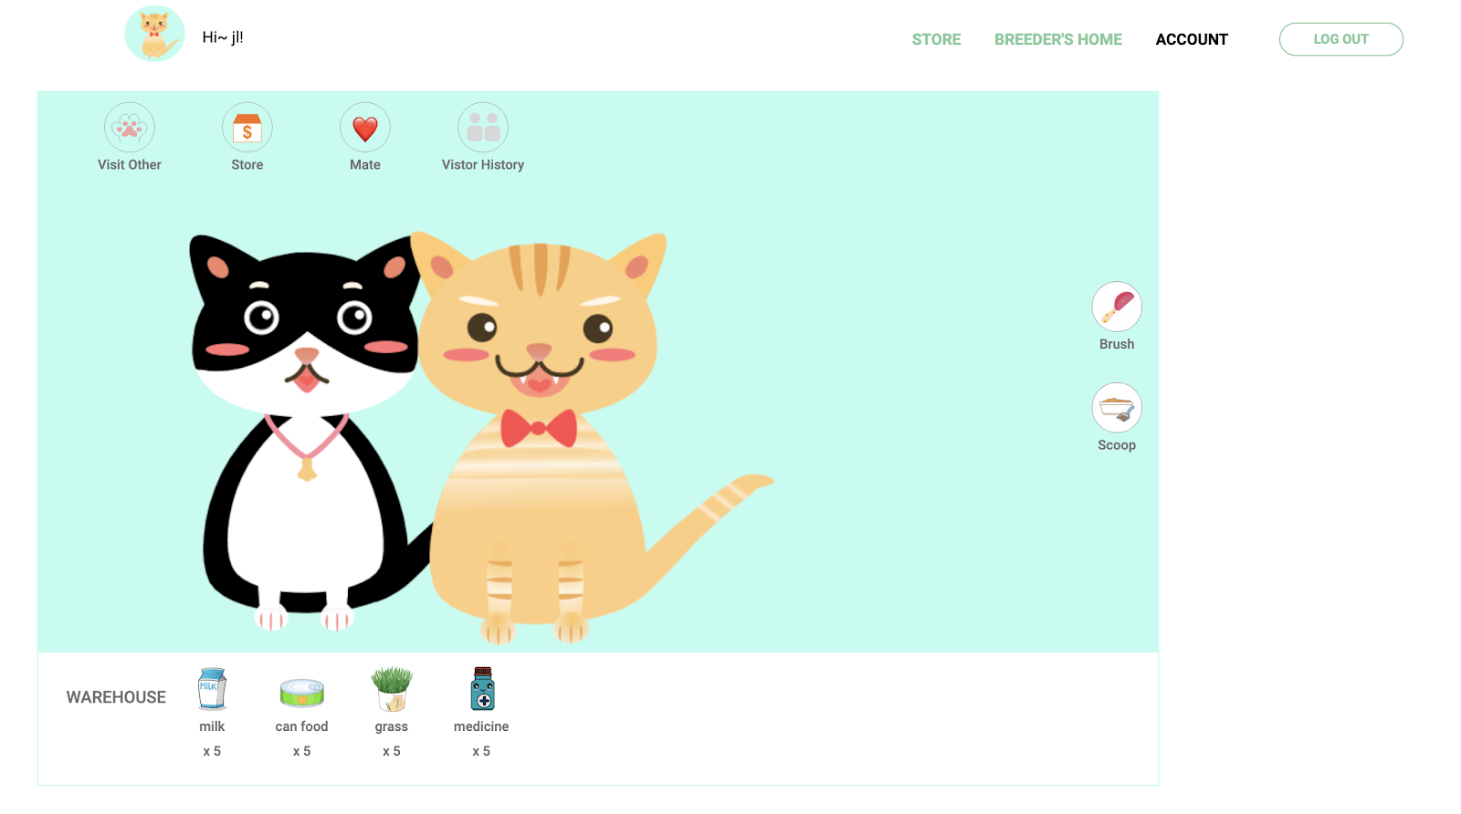
Progress
Notes:
Once logged in, user can enter their own breeder home page. In the canvas we can see several static cat image, which are objects representing user’s cats added by Collie package. We are going to add further interaction between the Collie objects and users like petting, feeding and so on.

Slide 8
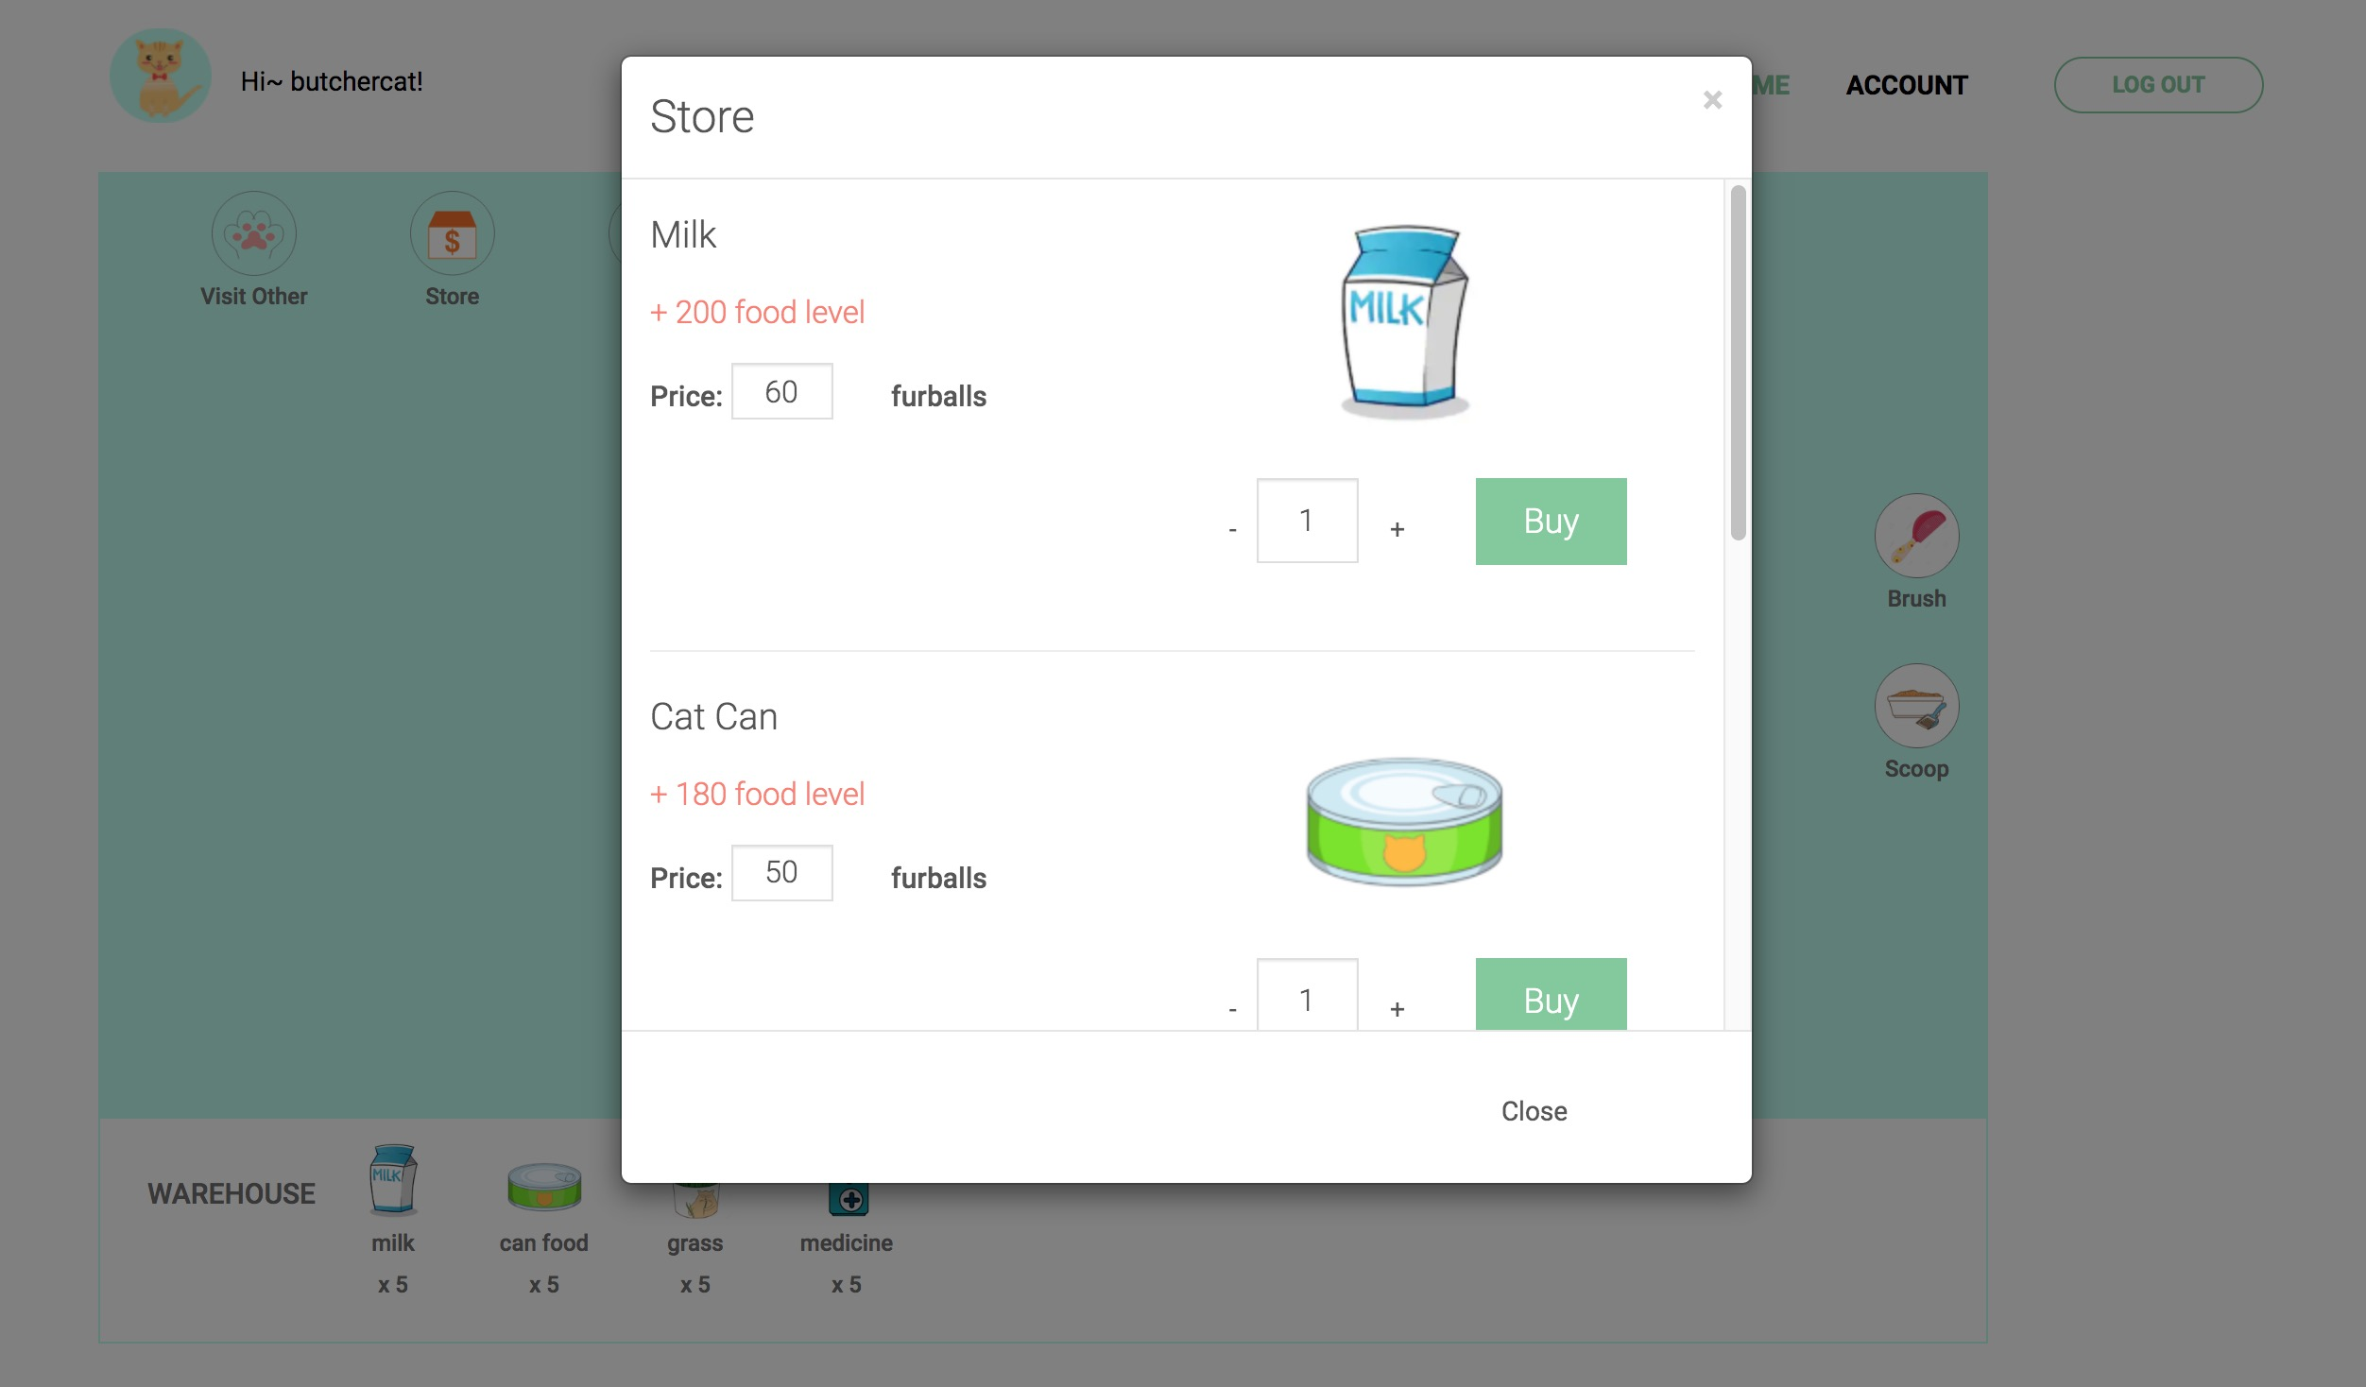
Progress
Notes:
Use can enter store from navbar and purchase using virtual currency for their pets’ daycare. This is the current view of store page and we would complete related functions later.

Slide 9
Future plan
Notes:
In the next iteration we plan to implement all the function of each button, the interaction between front end and back end and auto update for cats’ states. Also, we plan to introduce some other interest features like see friends’ cats and let them mate.

